Slide 1
Deploying, Moving, and Rearranging SharePoint Data
Module 11

Slide 2
Options for moving content
Bulk Uploads
Save Site as Template
Stsadm and SPD
Manage Content and Structure
Content Deployment Jobs

Slide 3
Uploading documents
Upload
Upload multiple files
Only if you have Office 2003 or later
Explorer view
Map a drive
\\fqdn\document library
Enable web client service
Notes:
Microsoft Office Version Comparison vs. SharePoint http://www.microsoft.com/downloads/details.aspx?FamilyID=e0d05a69-f67b-4d37-961e-2db3c4065cb9&DisplayLang=en

Slide 4
Demo!
Uploading files to SharePoint

Slide 5
Reusing Sites
Save site as template
Available from Site Settings
Works for all sites except publishing sites
Can choose to include content or not
Default template limit 10 MB
Change via command line
Change to max of 500 MB
Stsadm.exe –o setproperty – pn max-template-document-size –pv 524288000
Does not save security

Slide 6
Site Templates Usage
Save Site as template
Saved to Site Template Gallery
1 per Site Collection
Template is now available throughout the Site Collection

Slide 7
Use Template Globally
Deploy via command line
Add Template
Stsadm –o addttemplate –filename YourFile.stp –title YourTitle –description YourDesc
Delete Template
Stsadm –o deletetemplate –title YourTitle
List Templates
Stsadm –o enumtemplates
After running Add/Delete IISReset required

Slide 8
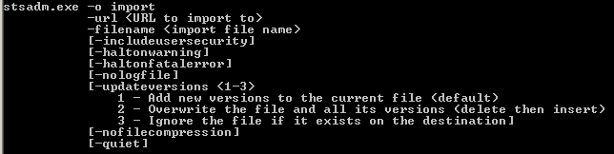
The command line
STSADM.exe is your friend
Import/Export

Slide 9
SPD?
SharePoint Designer of course
Gives backup restore option
Same output at export/import
Gives option for doing subsites
Doesn’t require command line access

Slide 10
Publishing sites give you more
Manage Content and Structure
Web based tools
Allows
Moving/Copying/Deleting Sites
Allows moving some list items
Allows bulk operations (check in, publish, etc)

Slide 11
Demo!
A casual stroll through Manage Content & Structure

Slide 12
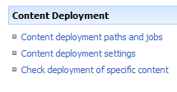
Moving from dev to prod
Content Deployment Jobs
One-way process
Multi-tier? No problem
Config doesn’t change

Slide 13
Paths & Jobs
Paths
Connects two site collection
Same or different farm
Jobs
When things get moved
What are those things
Quick deploy jobs
Automatically created
Allows pushing of just an item when needed

Slide 14
Setup
Done through central admin
Target should start as blank site template

Slide 15
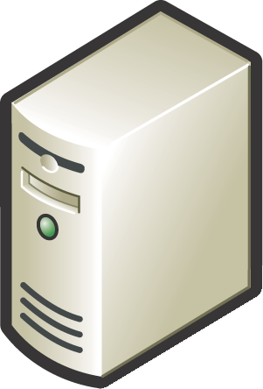
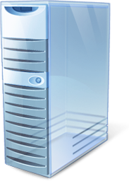



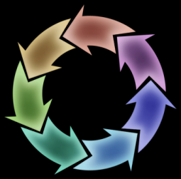
Content Deployment Process
1) Check change log on source server for content to package
2) Package changes on source server
3) Send package to destination server
?
!
5) Update change log on source server
4) Apply changes to destination server

Slide 16
Demo
Setup Content Deployment
Deploy a portal

